Slide 1
CSE 707
Distributed Computing Systems
To Course Instructor: Annajiat Alim Rasel
By Ripa Sarkar
Group Number: 12

Slide 2
Paper Title
“Distributed Sensor Data Computing in Smart City Applications”
by Wei Wang, Suparna De, Yuchao Zhou, Xin Huang, and Klaus Moessner

Slide 3
Abstract
Utilizing, Internet of Things (IoT) technologies, embedded devices are integrated into urban environments, generating continuous data. This “big data” is recognized as a valuable asset for intelligent applications. As IoT data sizes increase, it becomes inefficient to transfer all raw data to centralized cloud data centers. This study proposes “distributed intelligence,” distributing computation to smaller autonomous units like sensor network gateways or edge clouds to reduce data sizes. This approach enhances data quality, reduces latency and improves services, as demonstrated in a case study on urban air pollution monitoring and visualization.

Slide 4
Introduction
Understanding the Evolution of IoT :
A decade ago: Focus on traceability and accessibility via RFID tags.
Evolution: From worldwide network of uniquely addressable objects to emphasis on interoperability, representation and abstraction.
Recent Shift: Smart and intelligent IoT applications driven by the power of “data”, especially big data.
Challenge: Growing IoT data size and velocity necessitate distributed data processing for efficiency.

Slide 5
Fog Computing and Mobile Edge Computing
Addressing Data Processing Challenges
Fog computing and Mobile Edge Computing (MEC) enable cloud capabilities at the edge of networks.
Elastic resources for distributed data processing.
Advantages: Reduced latency, improved quality of services, efficient computation and less dependence on centralized data centers.
Example: Sensor data pre-processing at the edge to minimize latency.

Slide 6
Data Computing Architecture
Two Ways to Acquire Sensor Data:
Discover sensor services and subscribe or directly search streaming databases in edge clouds.
Edge clouds offer storage, sensor service discovery and search functionalities.
Quality consideration: Intelligent processing within the distributed framework ensures data quality for further analytics.

Slide 7
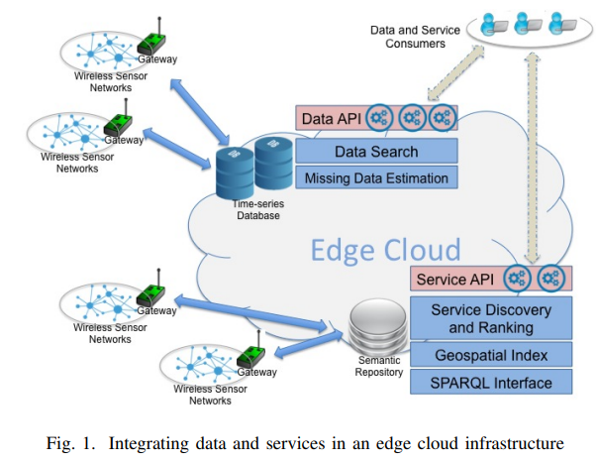
Data Computing Architecture
Integrating data and services in an edge cloud infrastructure

Slide 8
Semantic Modelling and Representation
Ensuring Interoperability and Scalability:
Importance of semantic technologies and service-oriented architecture for IoT.
Ontological models for sensor services and data allow fine-grained semantic annotations and linked data.
Simplified model for sensor data suits mobile sources with changing spatial and temporal properties.

Slide 9
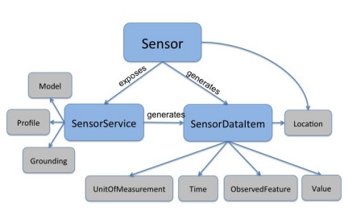
Semantic Modelling and Representation
Simplified semantic model for sensor and sensor Data

Slide 10
Service Discovery and Ranking
Efficient Discovery Mechanism:
Challenges in semantic sensor service discovery: Spatial indexing and semantic search.
Efficiently finding sensor services on a large scale, considering the dynamic nature of Wireless Sensor Networks (WSNs).
Novel ranking method based on WSN contextual information, ensuring energy-efficient service access.

Slide 11
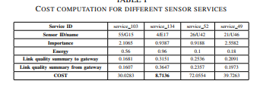
Service Discovery and Ranking
Cost Computation for Different Sensor Services

Slide 12
Data Query and Search
Retrieving Sensor Data:
Searching time-series databases for sensor data.
Suitable for fixed and mobile sensors.
Criteria for queries include location observed features and spatial extent.
Aggregation operations supported for data values.

Slide 13
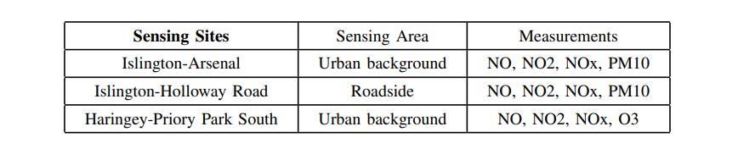
Data Query and Search
Information about the Sensing Sites and Air Quality Measurements

Slide 14
Improving Data Quality Using Regression Analysis
Ensuring Data Quality:
Data quality challenges in sensor and big data.
Application of Support Vector Regression (SVR) for predicting missing values.
Comparison with Locally Weighted Regression (LWR) shows SVR’s stability and better accuracy.

Slide 15
Case Study: Urban Air Pollution
Applying Distributed intelligence in a Real-World Scenario:
Utilizing techniques for sensor data acquisition, discovery and missing value estimation.
Air quality monitoring application for mobile phones.
Visualizing Air Quality Index (AQI) through a heat map for central London.
Addressing health threat and enabling timely actions based on pollution levels.

Slide 16
Conclusion & Future Work
Looking Ahead in IoT and Smart Cities
Distribution of intelligent computation to local resources as a foundation for application independent data processing.
Focus on sensor data from WSNs but applicable to various smart city applications.
Future Research Directions: Knowledge representation, discovery techniques and continuous analytics for trustworthy insights in smart cities.

Slide 17
References
[1] L. Atzori, A. Iera, and G. Morabito, “The Internet of Things: A survey,” Computer Networks, vol. 54, pp. 2787–2805, 2010.
[2] D. Guinard, V. Trifa, S. Karnouskos, P. Spiess, and D. Savio, “Interacting with the SOA-Based Internet of Things: Discovery, Query, Selection, and On-Demand Provisioning of Web Services,” IEEE Trans. Serv. Comput., vol. 3, no. 3, pp. 223–235, Jul. 2010.
[3] Datta, Soumya Kanti and Bonnet, Christian and Harri, J ¨ er´ ome, “Fog ˆ computing architecture to enable consumer centric Internet of Things services,” in 19th IEEE International Symposium on Consumer Electronics, ISCE 2015, 06 2015, pp. 1–2.
[4] ETSI, contributing organisations: Huawei, IBM, Intel, Nokia Networks, NTT Docomo, Vodafone, “Mobile-Edge Computing - Introductory Technical White Paper,” 2014.
[5] W. Wang, S. De, G. Cassar, and K. Moessner, “An experimental study on geospatial indexing for sensor service discovery,” Expert Syst. Appl., vol. 42, no. 7, pp. 3528–3538, 2015.
[6] W. Wang, F. Yao, S. De, K. Moessner, and Z. Sun, “A Ranking Method for Sensor Services Based on Estimation of Service Access Cost,” Information Sciences, Elsevier, vol. 319, pp. 1–17, 2015.
[7] Y. Qin, Q. Z. Sheng, N. J. Falkner, S. Dustdar, H. Wang, and A. V. Vasilakos, “When things matter: A survey on data-centric internet of things,” Journal of Network and Computer Applications, vol. 64, pp. 137 – 153, 2016.
[8] Y. Zhou, S. De, W. Wang, and K. Moessner, “Enabling query of frequently updated data from mobile sensing sources,” in The 13th IEEE International Conferences on Ubiquitous Computing and Communications (IUCC2014). IEEE, 2014, pp. 946 – 952.
[9] H. Kurasawa, H. Sato, A. Yamamoto, H. Kawasaki, M. Nakamura, Y. Fujii, and H. Matsumura, “Missing sensor value estimation method for participatory sensing environment,” in Pervasive Computing and Communications (PerCom), 2014 IEEE International Conference on. IEEE, 2014, pp. 103–111.
[10] World Health Organisation, “Global Health Risks: Mortality and burden of disease attributable to selected major risks,” 2009.

Slide 18
Thank you

